Slide 1

Lab 02 Lesson 03
Dart Functions & Object-Oriented Programming (OOP)
TMA3084 Software Engineering Lab (G01)
Lab Demonstrator
Muhammad Irfan Nabyl bin Mohamad Yaakub (84712)
Lecturer
Ts Nurfauza binti Jali
TMA3084 (G01) 2025/2026-1

Slide 2
Table of Contents
Functions
  Function Structure
  Creating a Function
  Function Return Data Types
  Void Function
  Function Returning Expression
  Functions and Variable Scope
  Object-Oriented Programming (OOP)
  Object
Class
  Creating a Class
  Adding Methods to Classes
  Your Classes
  Class — Getters and Setters
  Class Inheritance
  Abstract Class
  Dart Project Structure and Dart Libraries
Lab 3: Create a Small Overtime Payment Program
TMA3084 (G01) 2025/2026-1

Slide 3
Function
A set of programming statements
Can be called at any location of the program
  returns a result
  performs some operations
Saves time and effort in writing all the function statements one time
Help in organizing the program to structured parts
  program maintenance
  any future modifications
Has a unique name
  without the need to duplicate statements in multiple source code files
Come with a prewritten set of functions that are kept in a library
TMA3084 (G01) 2025/2026-1

Slide 4
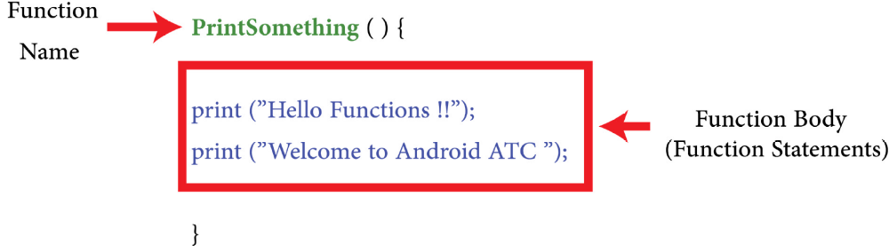
Function Structure
Function Name
Function Body
TMA3084 (G01) 2025/2026-1

Slide 5
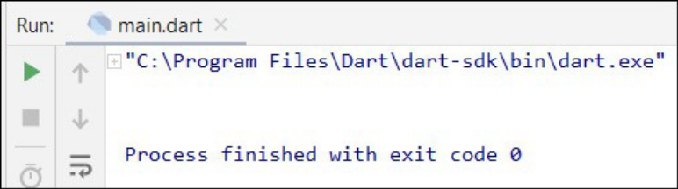
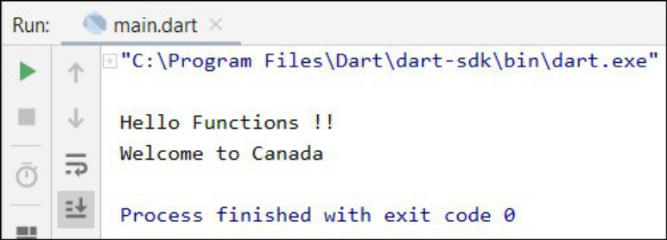
Creating a Function
main() {
}
PrintSomething() {
  print("Hello Functions !!");
  print("Welcome to Canada");
}
main() {
  PrintSomething();
}
PrintSomething() {
  print("Hello Functions !!");
  print("Welcome to Canada");
}
TMA3084 (G01) 2025/2026-1

Slide 6
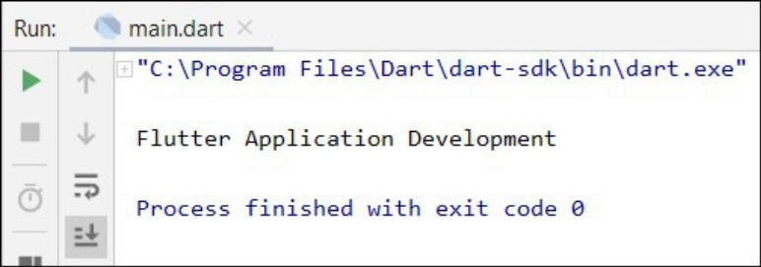
Function Return Data Types (1/3)
main() {
  CourseName();
}
String CourseName() {
  return "Flutter Application Development";
}
main() {
  print(CourseName());
}
PrintSomething() {
  return "Flutter Application Development";
}
TMA3084 (G01) 2025/2026-1

Slide 7
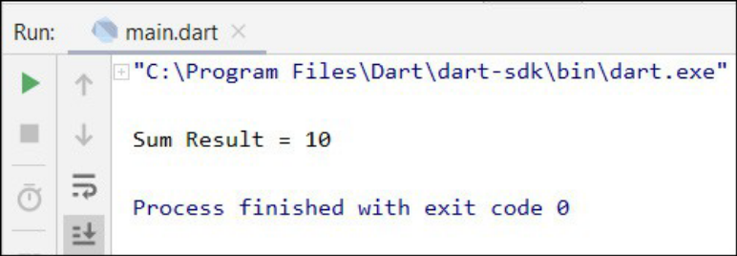
Function Return Data Types (2/3)
main() {
  var result = sumCalculator(3, 7);
  print('Sum result = $result');
}
int sumCalculator(x, y) {
  var z = x + y;
  return z;
}
main() {
  print('Sum result = ${sumCalculator(3, 7)}');
}
int sumCalculator(x, y) {
  var z = x + y;
  return z;
}
TMA3084 (G01) 2025/2026-1

Slide 8
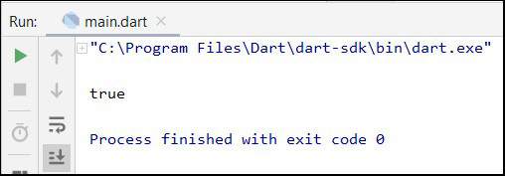
Function Return Data Types (3/3)
main() {
  print(age(20));
}
bool age(x) {
  if (x >= 18) {
    return true;
  } else {
    return false;
  }
}
TMA3084 (G01) 2025/2026-1

Slide 9
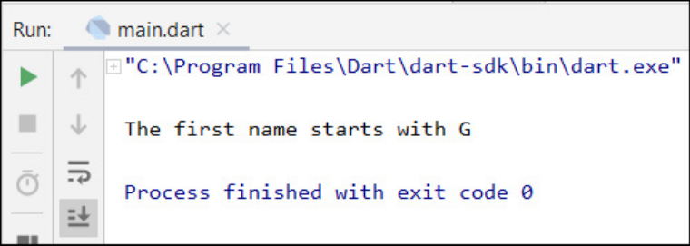
Void Function
main() {
  myFunction();
}
void myFunction() {
  var firstName = 'George';
  if (firstName.startsWith('G')) {
    print('The first name starts with G');
  } else {
    print('The first name does not start with G');
  }
}
TMA3084 (G01) 2025/2026-1

Slide 10
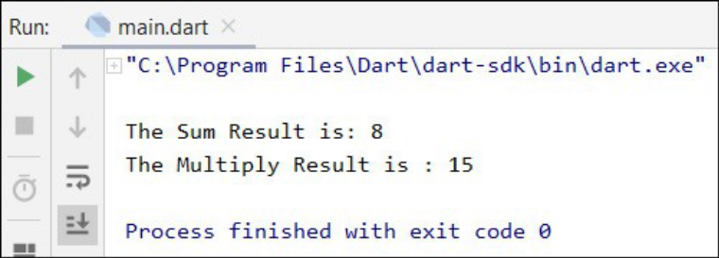
Function Returning Expression (1/2)
main() {
  print('The sum result is: ${sum(3, 5)}');
  print('The multiply result is: ${multiply(3, 5)}');
}
sum(x, y) {
  var z = x + y;
  return z;
}
multiply(x, y) {
  var w = x * y;
  return w;
}
TMA3084 (G01) 2025/2026-1

Slide 11
Function Returning Expression (2/2)
main() {
  print('The sum result is: ${sum(3, 5)}');
  print('The multiply result is: ${multiply(3, 5)}');
}
sum(x, y) => x + y;
multiply(x, y) => x * y;
TMA3084 (G01) 2025/2026-1

Slide 12
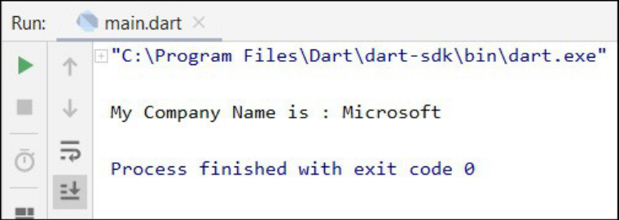
Functions and Variable Scope (1/3)
Global variable scope
var name = 'Microsoft';
main() {
  companyName(name);
}
companyName(name) {
  print('My company name is: $name');
}
TMA3084 (G01) 2025/2026-1

Slide 13
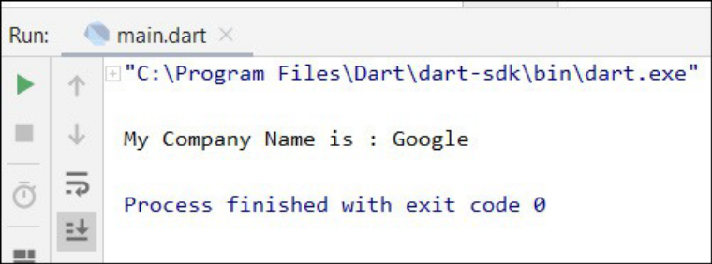
Functions and Variable Scope (2/3)
Local variable scope
var name = 'Microsoft';
main() {
  companyName(name);
}
companyName(name) {
  var name = 'Google';
  print('My company name is: $name');
}
TMA3084 (G01) 2025/2026-1

Slide 14
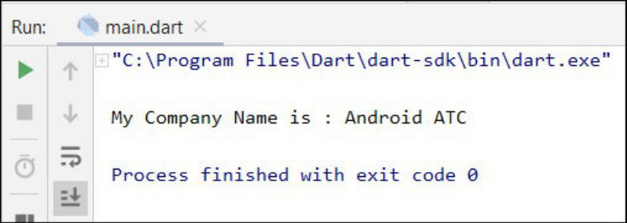
Functions and Variable Scope (3/3)
Local variable scope
var name = 'Microsoft';
main() {
  companyName('Android ATC');
}
companyName(name) {
  print('My company name is: $name');
}
TMA3084 (G01) 2025/2026-1

Slide 15
Object-Oriented Programming (OOP)
Objects
Classes
Inheritance
Interfaces
Packages
TMA3084 (G01) 2025/2026-1

Slide 16
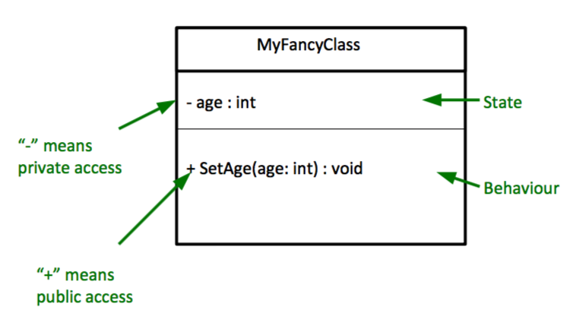
Object
Has state
  Properties
Has behaviour
  Methods
TMA3084 (G01) 2025/2026-1

Slide 17
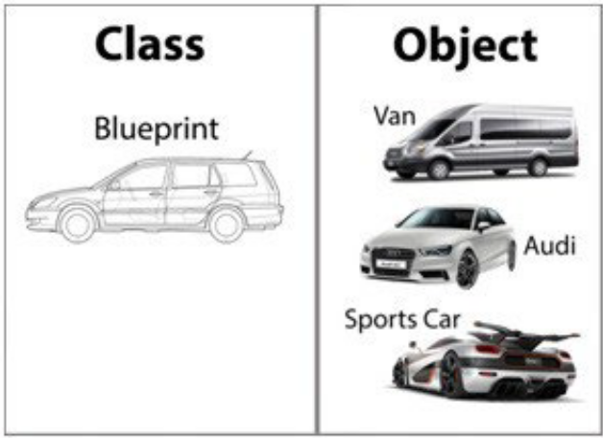
Class
A blueprint or prototype
Defines a class that models the state and behavior
Characterized by properties and functions
    Properties – Price, Type, Max. Speed, Seat No.
    Functions – NumberOfSeats, NumberOfWheels, getYearBuild
TMA3084 (G01) 2025/2026-1

Slide 18
Creating a Class (1/3)
#1: Pre-defined value
#2: late keyword
#3: Nullable value
class Car {
String type = '';
String color = '';
int MaxSpeed = 180;
int NumOfSeats = 4;
}
main() {
var toyota = new Car();
}
class Car {
late String type;
late String color;
late int MaxSpeed;
late int NumOfSeats;
}
main() {
var toyota = new Car();
}
class Car {
String? type;
String? color;
int? MaxSpeed;
int? NumOfSeats;
}
main() {
var toyota = new Car();
}
TMA3084 (G01) 2025/2026-1

Slide 19
Creating a Class (2/3)
class Car {
String? type;
String? color;
int? MaxSpeed;
int? NumOfSeats;
}
main() {
var toyota = new Car();
toyota.MaxSpeed = 200;
toyota.color = "red";
toyota.type = "Camry";
toyota.NumOfSeats = 7;
print("Car Type is: ${toyota.type}");
print("Number of Seats is : ${toyota.NumOfSeats}");
}
TMA3084 (G01) 2025/2026-1

Slide 20
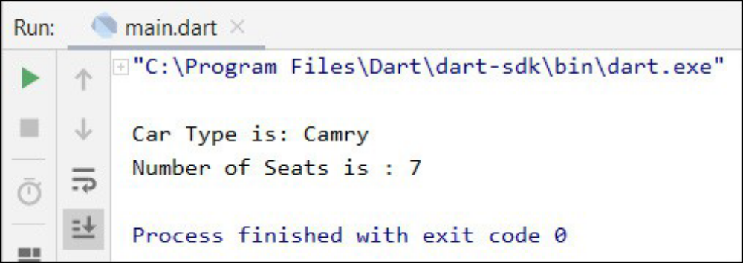
Creating a Class (3/3)
TMA3084 (G01) 2025/2026-1

Slide 21
Adding Methods to Classes (1/2)
class Car {
String? type;
String? color;
int? MaxSpeed;
int? NumOfSeats;
void CarSpeed(){
print("Car speed is : $MaxSpeed");
}
}
main() {
var toyota = new Car();
toyota.MaxSpeed = 200;
toyota.color = "red";
toyota.type = "Camry";
toyota.NumOfSeats = 7;
print("Car Type is: ${toyota.type}");
print("Number of Seats is : ${toyota.NumOfSeats}");
toyota.CarSpeed();
}
TMA3084 (G01) 2025/2026-1

Slide 22
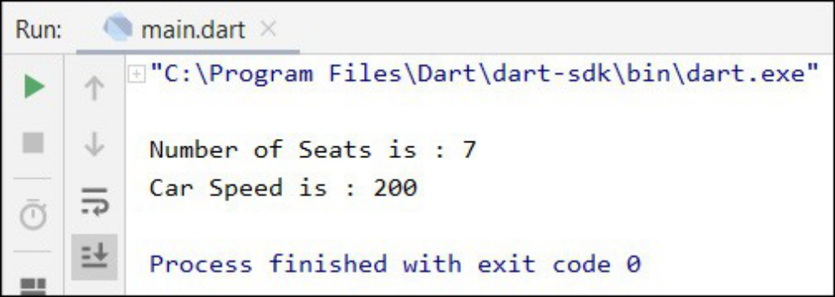
Adding Methods to Classes (2/2)
TMA3084 (G01) 2025/2026-1

Slide 23
Providing Constructors for Your Classes (1/4)
class Car {
String? type;
String? color;
int? MaxSpeed;
int? NumOfSeats;
// Method 1
Car(type, color, MaxSpeed, NumOfSeats) {
this.type = type;
this.color = color;
this.MaxSpeed = MaxSpeed;
this.NumOfSeats = NumOfSeats;
}
void CarSpeed() {
print("Car speed is : $MaxSpeed");
}
}
main() {
var toyota = new Car("Camry", "red", 200, 4);
print("Car Type is: ${toyota.type}");
print("Number of Seats is : ${toyota.NumOfSeats}");
toyota.CarSpeed();
}
TMA3084 (G01) 2025/2026-1

Slide 24
Providing Constructors for Your Classes (2/4)
class Car {
String? type;
String? color;
int? MaxSpeed;
int? NumOfSeats;
// Method 2
Car(this.type, this. color, this. MaxSpeed, this. NumOfSeats);
void CarSpeed() {
print("Car speed is : $MaxSpeed");
}
}
main() {
var toyota = new Car("Camry", "red", 200, 4);
print("Car Type is: ${toyota.type}");
print("Number of Seats is : ${toyota.NumOfSeats}");
toyota.CarSpeed();
}
TMA3084 (G01) 2025/2026-1

Slide 25
Providing Constructors for Your Classes (3/4)
class Car {
String? type;
String? color;
int? MaxSpeed;
int? NumOfSeats;
// Method 3
Car.initialize(){
type = "Camry";
color = "red";
MaxSpeed = 200;
NumOfSeats = 4;
}
void CarSpeed() {
print("Car speed is : $MaxSpeed");
}
}
main() {
var toyota = new Car.initialize();
print("Car Type is: ${toyota.type}");
print("Number of Seats is : ${toyota.NumOfSeats}");
toyota.CarSpeed();
}
TMA3084 (G01) 2025/2026-1

Slide 26
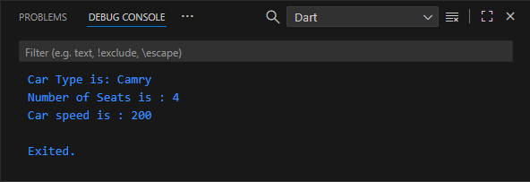
Providing Constructors for Your Classes (4/4)
TMA3084 (G01) 2025/2026-1

Slide 27
Class — Getters and Setters
Effectively protect your data, particularly when creating classes
A getter method returns its value
  get keyword
A setter method sets or updates its value
  set keyword
class Car {
String? type;
String? color;
int? MaxSpeed;
int? NumOfSeats;
set setType(String value) => type = value;
String? get getType => type;
}
main() {
var toyota = new Car();
toyota.setType = "Bus";
print(toyota.getType);
}
TMA3084 (G01) 2025/2026-1

Slide 28
Class Inheritance
Derive new class from the existing class – parent class or super class
reuse properties and methods of the existing class without rewriting again
class Student {
String? Name;
String? Address;
int? TelNumber;
String? Email;
}
class Teacher extends Student{}
main() {
var trainer = new Teacher();
trainer.Email = "test@gmail.com";
trainer.TelNumber = 123456789;
print("Email Address : ${trainer.Email}");
print("Telephone Number: ${trainer.TelNumber}");
}
TMA3084 (G01) 2025/2026-1

Slide 29
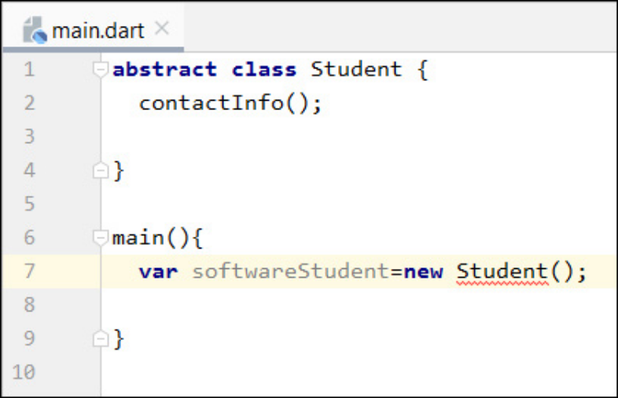
Abstract Class (1/3)
At least one of its methods or functions does not have an implementation (function body)
  Child class to provide the implementation
Its only purpose is to be inherited
  Cannot be instantiated
abstract class Student {
contactInfo();
}
main() {}
TMA3084 (G01) 2025/2026-1

Slide 30
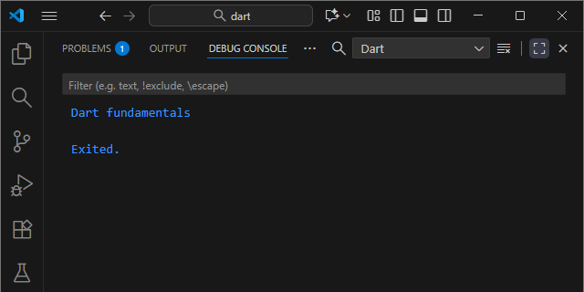
Abstract Class (2/3)
abstract class Student {
contactInfo();
}
class ITStudent extends Student {
@override
contactInfo() {
// TODO: implement contactInfo
print("Dart fundamentals");
}
}
main() {
var SoftwareStudent = new ITStudent();
SoftwareStudent.contactInfo();
}
TMA3084 (G01) 2025/2026-1

Slide 31
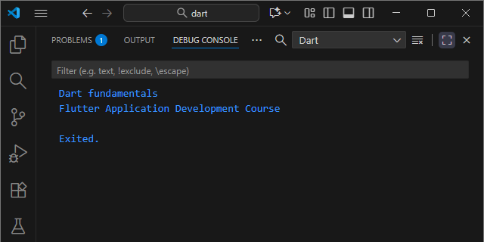
Abstract Class (3/3)
abstract class Student {
contactInfo();
CourseInfo() {
print("Flutter Application Development Course");
}
}
class ITStudent extends Student {
@override
contactInfo() {
// TODO: implement contactInfo
print("Dart fundamentals");
}
}
main() {
var SoftwareStudent = new ITStudent();
SoftwareStudent.contactInfo();
SoftwareStudent.CourseInfo();
}
TMA3084 (G01) 2025/2026-1

Slide 32
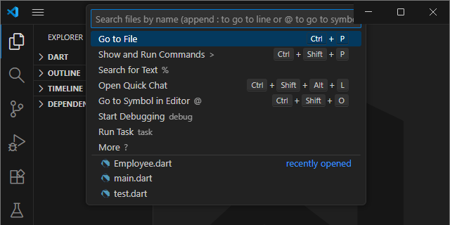
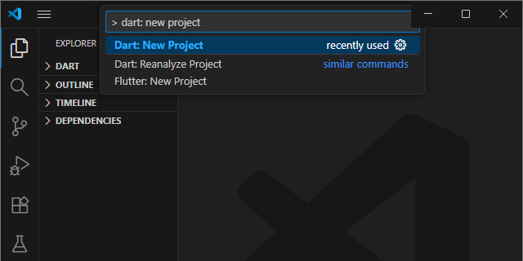
Dart Project Structure and Dart Libraries (1/4)
Create new Dart Project
1
2
TMA3084 (G01) 2025/2026-1

Slide 33
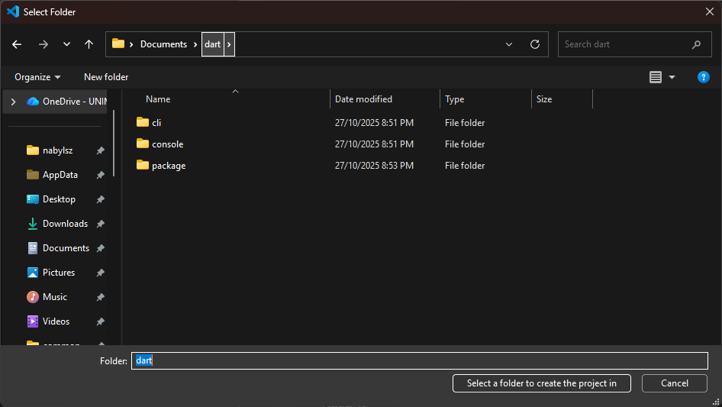
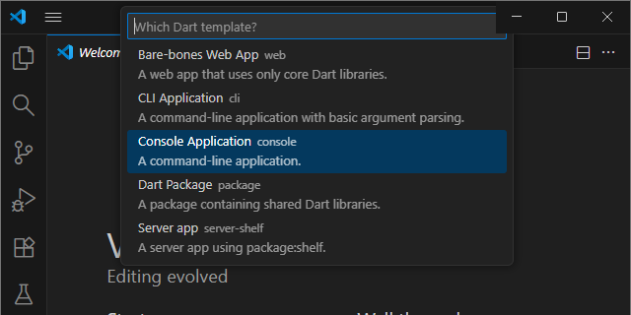
Dart Project Structure and Dart Libraries (2/4)
4
3
1
2
TMA3084 (G01) 2025/2026-1

Slide 34
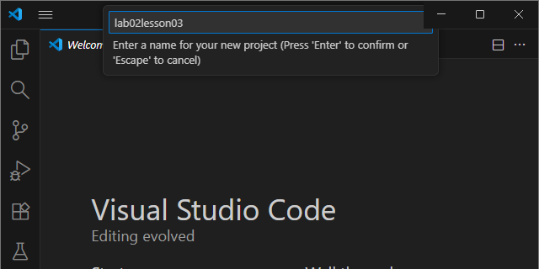
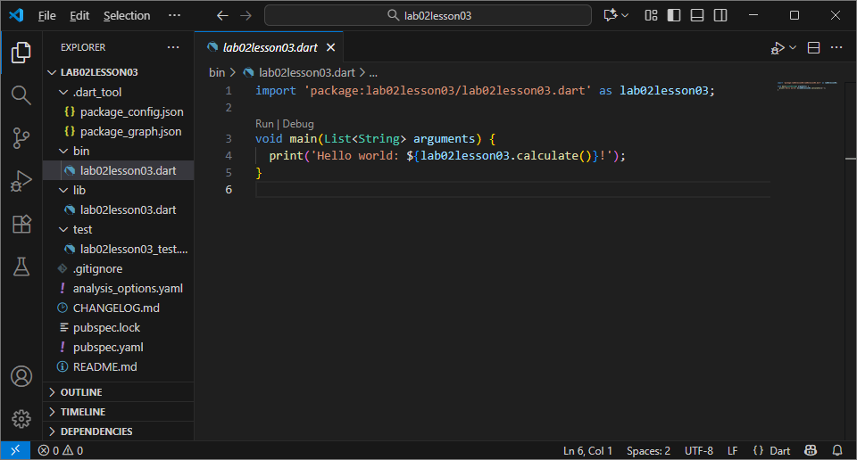
Dart Project Structure and Dart Libraries (3/4)
5
6
TMA3084 (G01) 2025/2026-1

Slide 35
Dart Project Structure and Dart Libraries (4/4)
Folders
  bin – public entry points of a command-line application
  lib – all reusable Dart code and libraries
  test – project unit and integration tests
TMA3084 (G01) 2025/2026-1

Slide 36
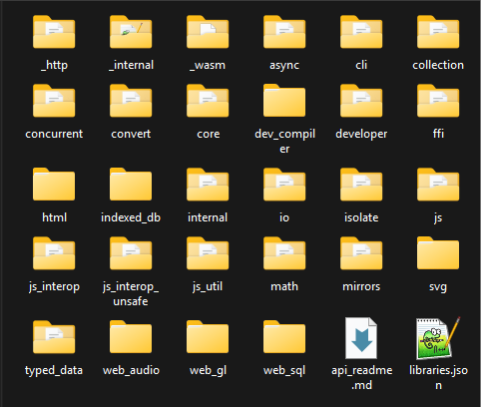
Dart Libraries (1/5)
A collection of pre-written code, such as functions, classes, and procedures, that provides specific functionalities and can be reused by other programs
Dart libraries – Has the libraries and command-line tools needed to develop Dart web, command-line, and mobile apps
TMA3084 (G01) 2025/2026-1

Slide 37
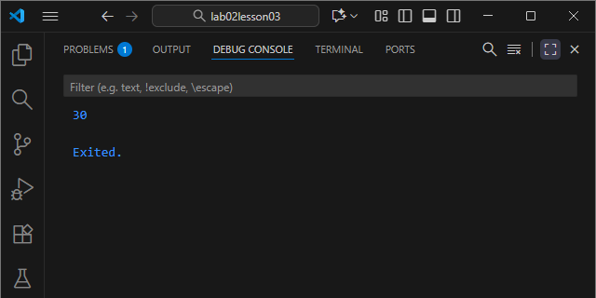
Dart Libraries (2/5)
Use Dart’s math library:
import 'dart:math' as math;
  as math: use it as reference to use this library
import 'dart:math' as math;
void main() {
print(math.max(5, 30));
}
TMA3084 (G01) 2025/2026-1

Slide 38
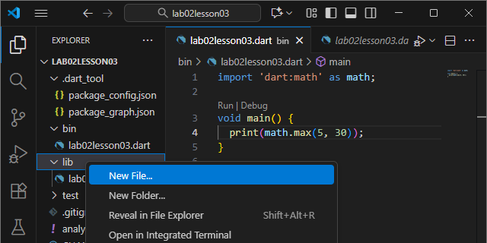
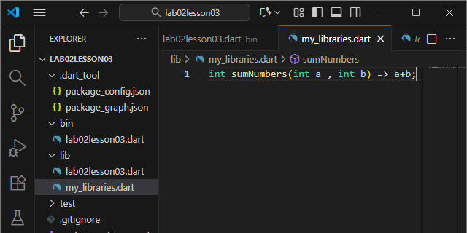
Dart Libraries (3/5)
Use own library:
  Create new file “my_libraries.dart” inside “lib” folder
  Type in code below into file:
int sumNumbers(int a , int b) => a+b;
TMA3084 (G01) 2025/2026-1

Slide 39
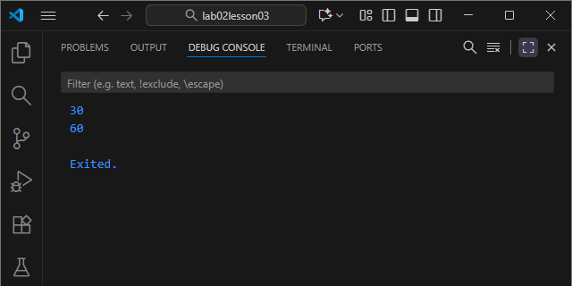
Dart Libraries (4/5)
  Import own library
    as mylib: use it as reference to use this library
import 'dart:math' as math;
import 'package:lab02lesson03/my_libraries.dart' as mylib;
void main() {
print(math.max(5, 30));
print(mylib.sumNumbers(10, 50));
}
TMA3084 (G01) 2025/2026-1

Slide 40
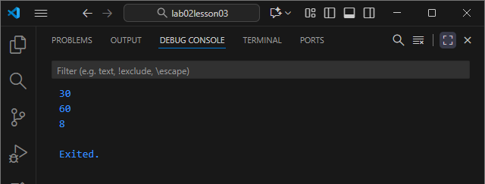
Dart Libraries (5/5)
  Add new function in my_libraries.dart
// bin/lab02lesson03.dart
import 'dart:math' as math;
import 'package:lab02lesson03/my_libraries.dart' as mylib;
void main() {
print(math.max(5, 30));
print(mylib.sumNumbers(10, 50));
print(mylib.multiplyNumbers(2, 4));
}
// lib/my_libraries.dart
int sumNumbers(int a , int b) => a+b;
int multiplyNumbers(int c, int d) => c*d;
  Use function in lab02lesson03.dart
TMA3084 (G01) 2025/2026-1

Slide 41
Lab 3: Create a Small Overtime Payment Program (1/2)
Create new Dart console application project (e.g. lab3)
(Optional) Rename the following:
  bin/lab3.dart → bin/main.dart
Create new file in “lib” folder:
  employee.dart
TMA3084 (G01) 2025/2026-1

Slide 42
Lab 3: Create a Small Overtime Payment Program (2/2)
// lib/employee.dart
class Employee {
String jobTitle = '';
String location = '';
double salary = 0.0;
double overtimeHr = 0.0; //Number of Overtime hours
Employee(this.jobTitle, this.location, this.salary, this.overtimeHr);
}
// bin/main.dart
import 'package:lab3/employee.dart' as emp_manager;
double extraPayPerHr = 0.0; // Extra Payment Per Hour
void main() {
var william = emp_manager.Employee("Manager", "Madrid", 5000.0, 7.0);
if (william.salary >= 4000.0) {
extraPayPerHr = 10.0;
} else {
extraPayPerHr = 20.0;
}
double totalSalary = william.salary + (william.overtimeHr * extraPayPerHr);
print("Total Salary = $totalSalary USD");
}
TMA3084 (G01) 2025/2026-1

Slide 43
Thanks!
Any questions?
TMA3084 (G01) 2025/2026-1

